Slide 1
Service Oriented Architecture (SOA)
Service-oriented architecture (SOA) is a method of software development that uses software components called services to create business applications. Each service provides a business capability, and services can also communicate with each other across platforms and languages. Developers use SOA to reuse services in different systems or combine several independent services to perform complex tasks.
For example, multiple business processes in an organization require the user authentication functionality. Instead of rewriting the authentication code for all business processes, you can create a single authentication service and reuse it for all applications. Similarly, almost all systems across a healthcare organization, such as patient management systems and electronic health record (EHR) systems, need to register patients. These systems can call a single, common service to perform the patient registration task.

Slide 2
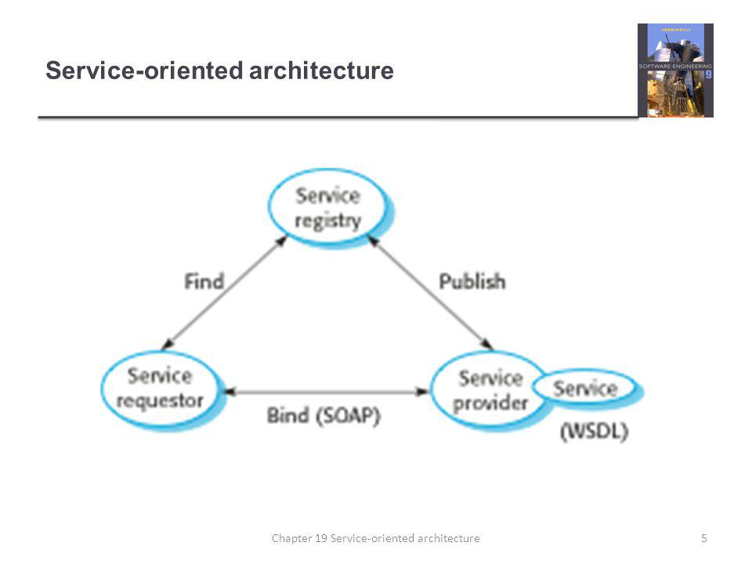

Slide 3
What are the benefits of service-oriented architecture?
Service-oriented architecture (SOA) has several benefits over the traditional monolithic architectures in which all processes run as a single unit. Some major benefits of SOA include the following:
Faster time to market
Developers reuse services across different business processes to save time and costs. They can assemble applications much faster with SOA than by writing code and performing integrations from scratch.
Efficient maintenance
It’s easier to create, update, and debug small services than large code blocks in monolithic applications. Modifying any service in SOA does not impact the overall functionality of the business process.
Greater adaptability
SOA is more adaptable to advances in technology. You can modernize your applications efficiently and cost effectively. For example, healthcare organizations can use the functionality of older electronic health record systems in newer cloud-based applications.

Slide 4
What are the basic principles of service-oriented architecture?
There are no well-defined standard guidelines for implementing service-oriented architecture (SOA). However, some basic principles are common across all SOA implementations.
Interoperability
Each service in SOA includes description documents that specify the functionality of the service and the related terms and conditions. Any client system can run a service, regardless of the underlying platform or programming language. For instance, business processes can use services written in both C# and Python. Since there are no direct interactions, changes in one service do not affect other components using the service.
Loose coupling
Services in SOA should be loosely coupled, having as little dependency as possible on external resources such as data models or information systems. They should also be stateless without retaining any information from past sessions or transactions. This way, if you modify a service, it won’t significantly impact the client applications and other services using the service.
Abstraction
Clients or service users in SOA need not know the service's code logic or implementation details. To them, services should appear like a black box. Clients get the required information about what the service does and how to use it through service contracts and other service description documents.

Slide 5
What are the components in service-oriented architecture?
There are four main components in service-oriented architecture (SOA).
Service
Services are the basic building blocks of SOA. They can be private—available only to internal users of an organization—or public—accessible over the internet to all. Individually, each service has three main features.
Service implementation
The service implementation is the code that builds the logic for performing the specific service function, such as user authentication or bill calculation.
Service contract
The service contract defines the nature of the service and its associated terms and conditions, such as the prerequisites for using the service, service cost, and quality of service provided.
Service interface
In SOA, other services or systems communicate with a service through its service interface. The interface defines how you can invoke the service to perform activities or exchange data. It reduces dependencies between services and the service requester. For example, even users with little or no understanding of the underlying code logic can use a service through its interface.

Slide 6
Ctd…
Service provider
The service provider creates, maintains, and provides one or more services that others can use. Organizations can create their own services or purchase them from third-party service vendors.
Service consumer
The service consumer requests the service provider to run a specific service. It can be an entire system, application, or other service. The service contract specifies the rules that the service provider and consumer must follow when interacting with each other. Service providers and consumers can belong to different departments, organizations, and even industries.
Service registry
A service registry, or service repository, is a network-accessible directory of available services. It stores service description documents from service providers. The description documents contain information about the service and how to communicate with it. Service consumers can easily discover the services they need by using the service registry.

